Slide 1
Welcome to the course!
Class 1: What even is culture?

Slide 2
Welcome!
Shall we do an icebreaker?

Slide 3
So what are we going to do in this course together?
By the end of the course I hope that you will:
Understand the term ‘behavioural modernity’
Gain an appreciation of the archaeological record of human culture
At the very least, find archaeology pretty cool!
In today’s class, we’re going to do the opposite of archaeological work and lay some groundwork!

Slide 4
What is NOT archaeology?

Slide 5
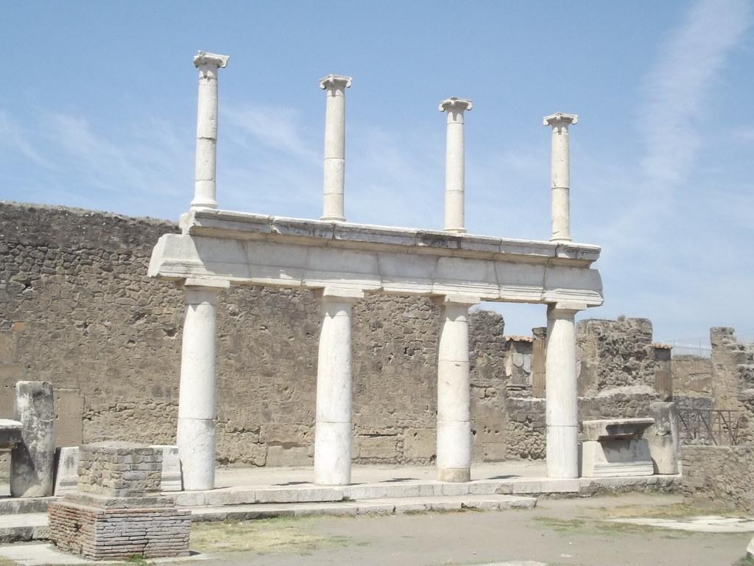
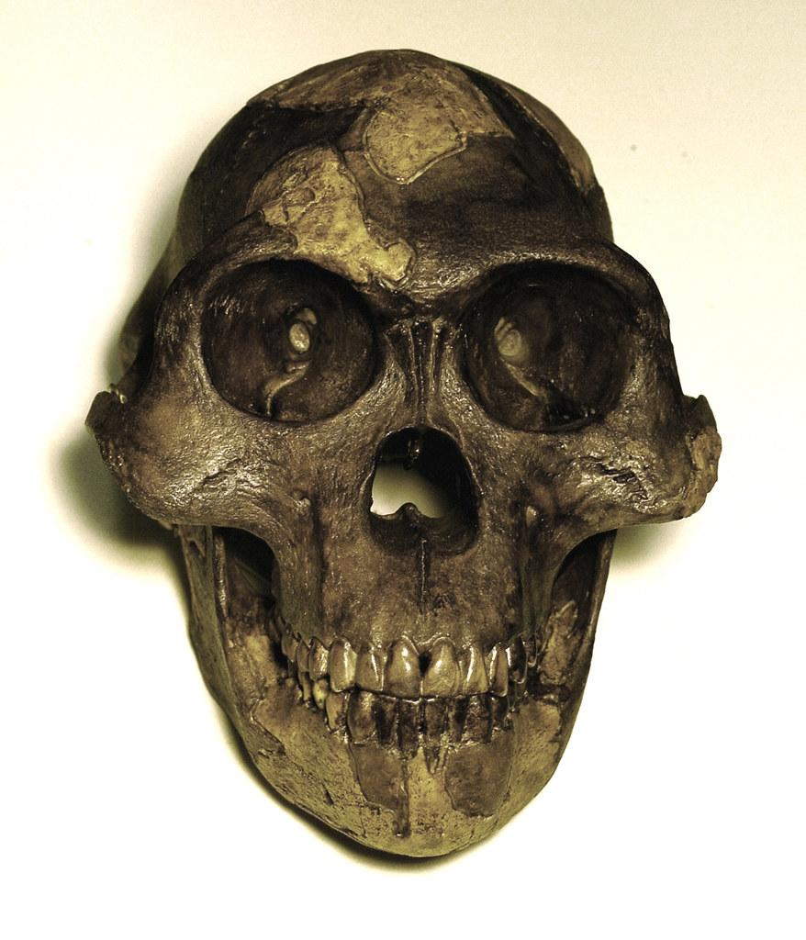
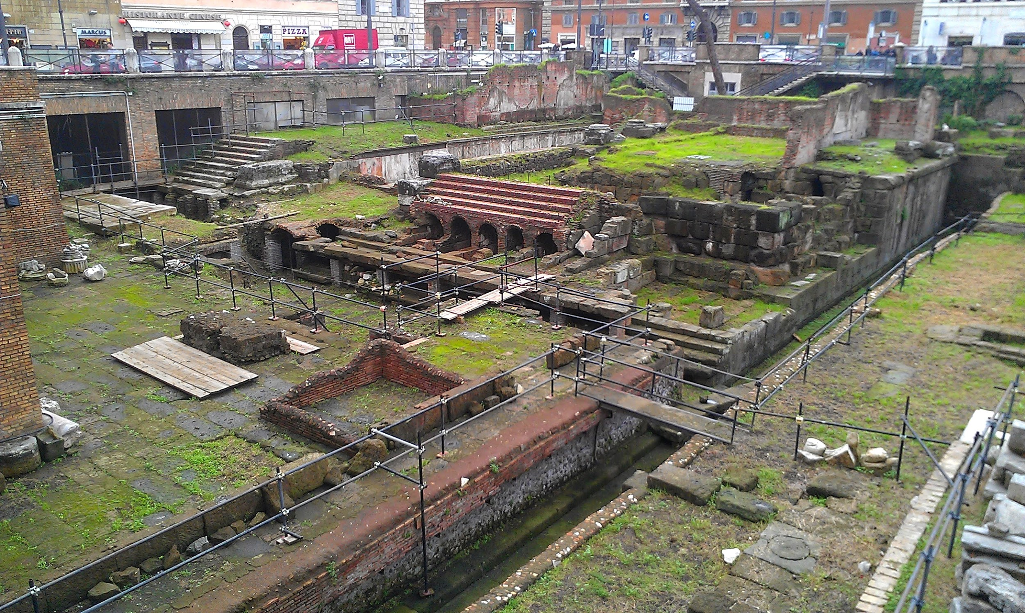
So what IS archaeology?

Slide 6
Now we’ve covered that...
Let’s think about what culture actually is more broadly.
What cultures do you consider yourself a part of?
Can you describe American culture? (Can I describe British culture?) And what oes that link mean?
Is culture the same as nationality?
More broadly, does culture make us human?
Notes:
Let’s kick things off with a debate - I’d like to split you into breakout rooms and we’ll have two-three smaller group discussions about these questions. Then we’ll regroup and consider!

Slide 7
So what did you all think?

Slide 8
Any guesses as to what ‘behavioural modernity’ means?

Slide 9
So how are we going to explore the concept of behavioural modernity?
Week by week, we’re going to explore this concept through different expressions of culture.
Next week, we’ll look at language and literature.
We’ll look then at art, music, food and technology!

Slide 10
So we’ll meet again next week?
bit.ly/culture-class-questions

